Slide 1

WISH-IT SOLUTIONS
Ultimate Destination for Home Utility Services
Group Members- Prashant Darade [220343120029]
Kunal Kshirsagar [220343120050]
Vikas Patil [220343120076]
Pranit Ghorpade [220343120081]
CDAC-Infoway Technologies Pvt. Ltd.-Batch March 2022

Slide 2
CONTENTS
Introduction
Choice of topic
Proposed System
Methodology
Proposed System Model
Proposed Approach
Screenshot
System Requirements
Applications
Advantages & Limitations
Conclusion
Future Scopes
References

Slide 3
Giving a thought to that aspect of life is to design and develop a system that provides many services at your doorstep in just one click.
A System that provides variety of services like electricians, painters, plumbers, movers and packers, repair persons, cleaners, electricians, painters and many more.
To make it comfortable for all the users our system also provides a mobile environment which offers ease in accessing our services.
System is versatile as service can be booked from everywhere to anywhere you desire.
INTRODUCTION

Slide 4
CHOICE OF TOPIC
In present scenario, people are buried up in a heavy work culture, as everyone is engaged with busy schedules, and hectic tasks which make them deviate from family life.
If any issues encounter unexpectedly, it distracts them and makes them choose over the work they have to accomplish primarily. It is important to manage both professional and family life.
In such situation’s E-Commerce plays a vital role in today’s life as it has so many advantages in our life because it makes convenient in daily life of the people.
We at WISH-IT aim to help in providing optimal solutions to all your household troubles with more efficiency, ease and majorly, a delicate touch.

Slide 5
Proposed System (B2C)
Wish-It is a platform to make our urban lives more fulfilling to solve our needs in a wish. Hence the name, Wish-It.
Better Communication with Customers: Prime advantages for this business is the increased efficiency of communication channels. Customers can directly resolve their queries and issues.
Order Tracking: Customers can track their orders and modify the orders at any point of time.
Service Suppliers: Wish-It focuses on hiring professionals for the service in each type. Thus leading to customer satisfaction and a voice of VOCAL FOR LOCAL.
Other Benefits:
Commission less approach
Eliminates Intermediate(B2C).
Lead generation
Advertisements- Service providers, businesses, and manufacturers run their advertisements through the WISH-IT platform.

Slide 6









METHODOLOGY
MICROSERVICES ARCHITECTURE: The most in demand architecture in IT industry for developing WEB based application.
JWT-TOKEN SECURITY: To provide an authenticated and authorized login module for the users such as service seekers, service providers and the admin, by providing appropriate credentials at the time of registration.
REACTJS FRONTEND: To develop a web based online system for opting household services and design a interactive User Interface for seeking services on the go.
JAVA BASED SPRING BACKEND: To provide data security and Object oriented programming which is lightweight, loose coupling, cross cutting behavior, declarative, powerful abstraction, fast and productive.

Slide 7
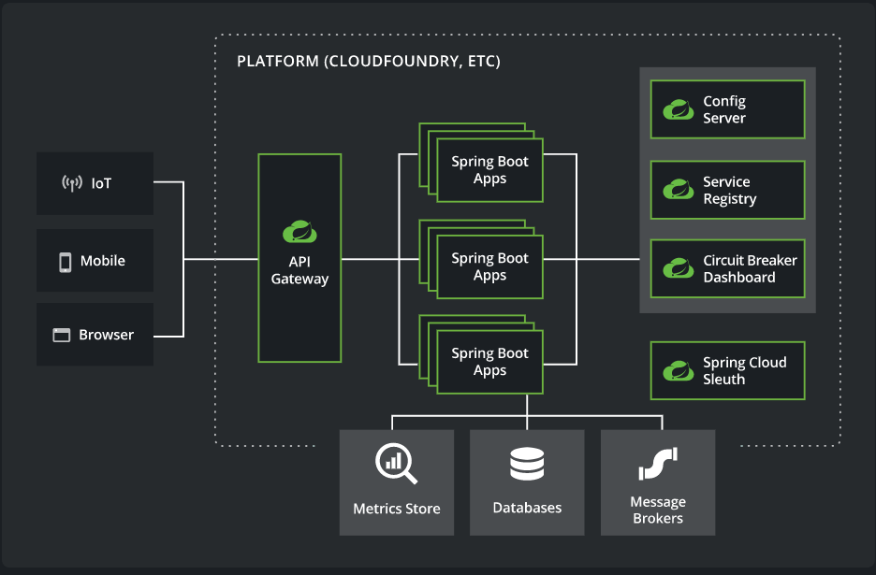
MICROSERVICES ARCHITECTURE

Slide 8
PROPOSED SYSTEM MODEL
PROPOSED SYSTEM MODEL
Administrator
Functionality for admin users.
Login For Admin
Forgot password for Admin
Edit Profile for Admin
Change Password for Admin
Logout Functionality
Dashboard for Admin User
Permission to admin user:
Manage Project
Manage customer User
Manage Service provider
Reports
Customer
Functionality for Customer users.
Register for client
Login for client
Forgot password for client
Edit Profile for client
Change Password for client
Logout Functionality
Dashboard for project work.
Permission to customer user:
Select service category.
Search service.
View service provider’s profile
and details
Select service provider.
Service provider
Functionality for Customer users.
Register for Service provider
Login For Service provider.
Forgot password for Service provider.
Edit Profile for Service provider.
Change Password for Service provider.
Logout Functionality.
Dashboard for project status.
Permission to service provider:
View pending client details
View client details
View service status

Slide 9
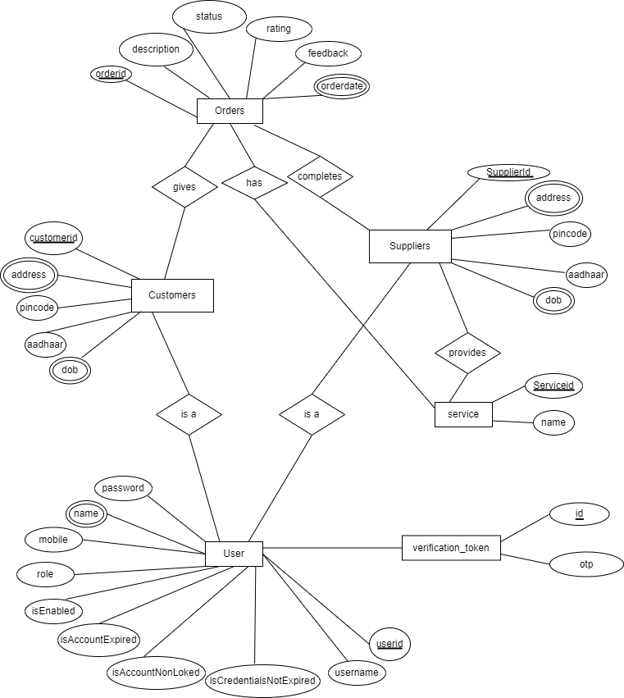
ENTITY RELATION DIAGRAM-PROPOSED APPROACH

Slide 10
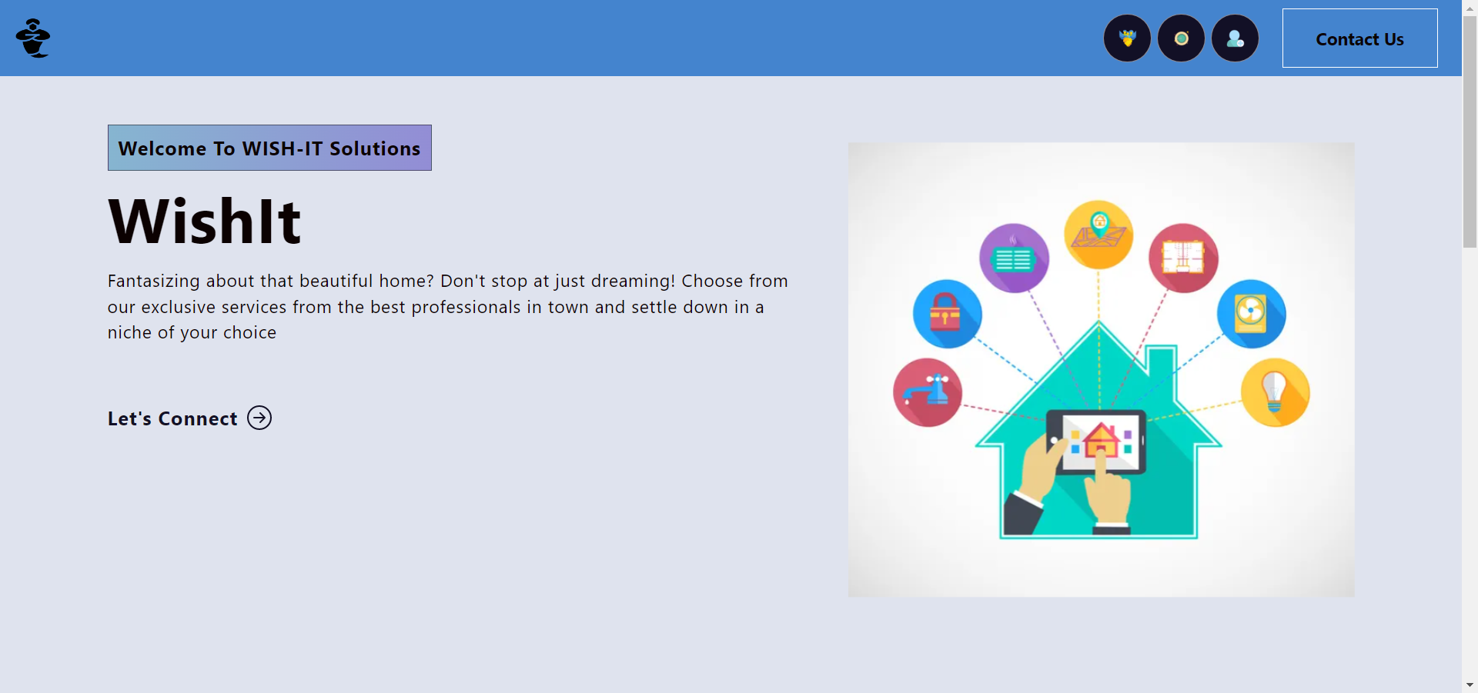
SCREENSHOTS- HOMEPAGE

Slide 11
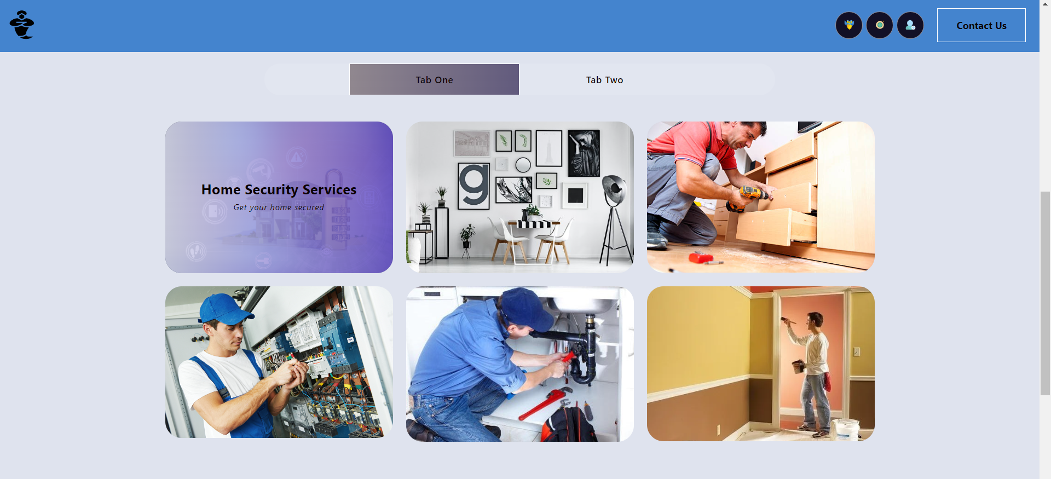
SCREENSHOTS- SERVICES TAB

Slide 12
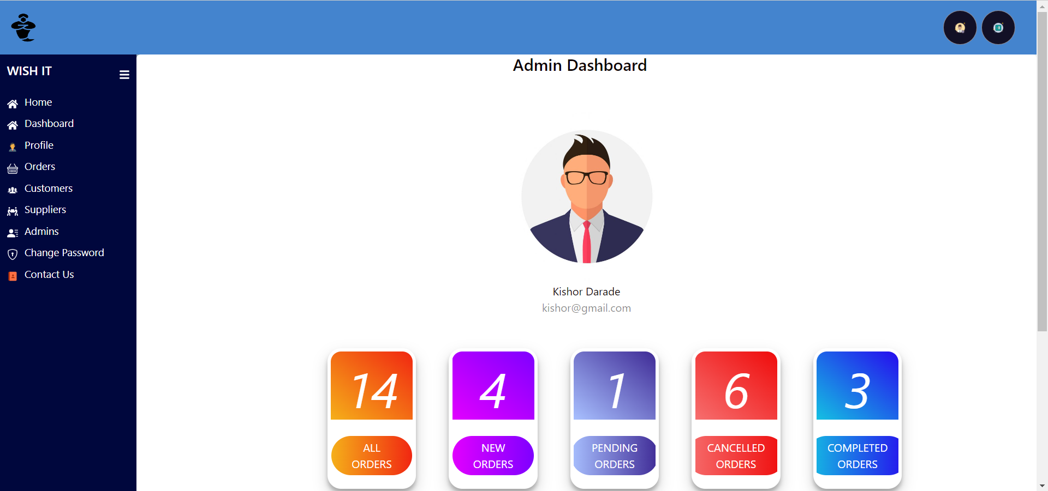
SCREENSHOTS- ADMIN DASHBOARD

Slide 13
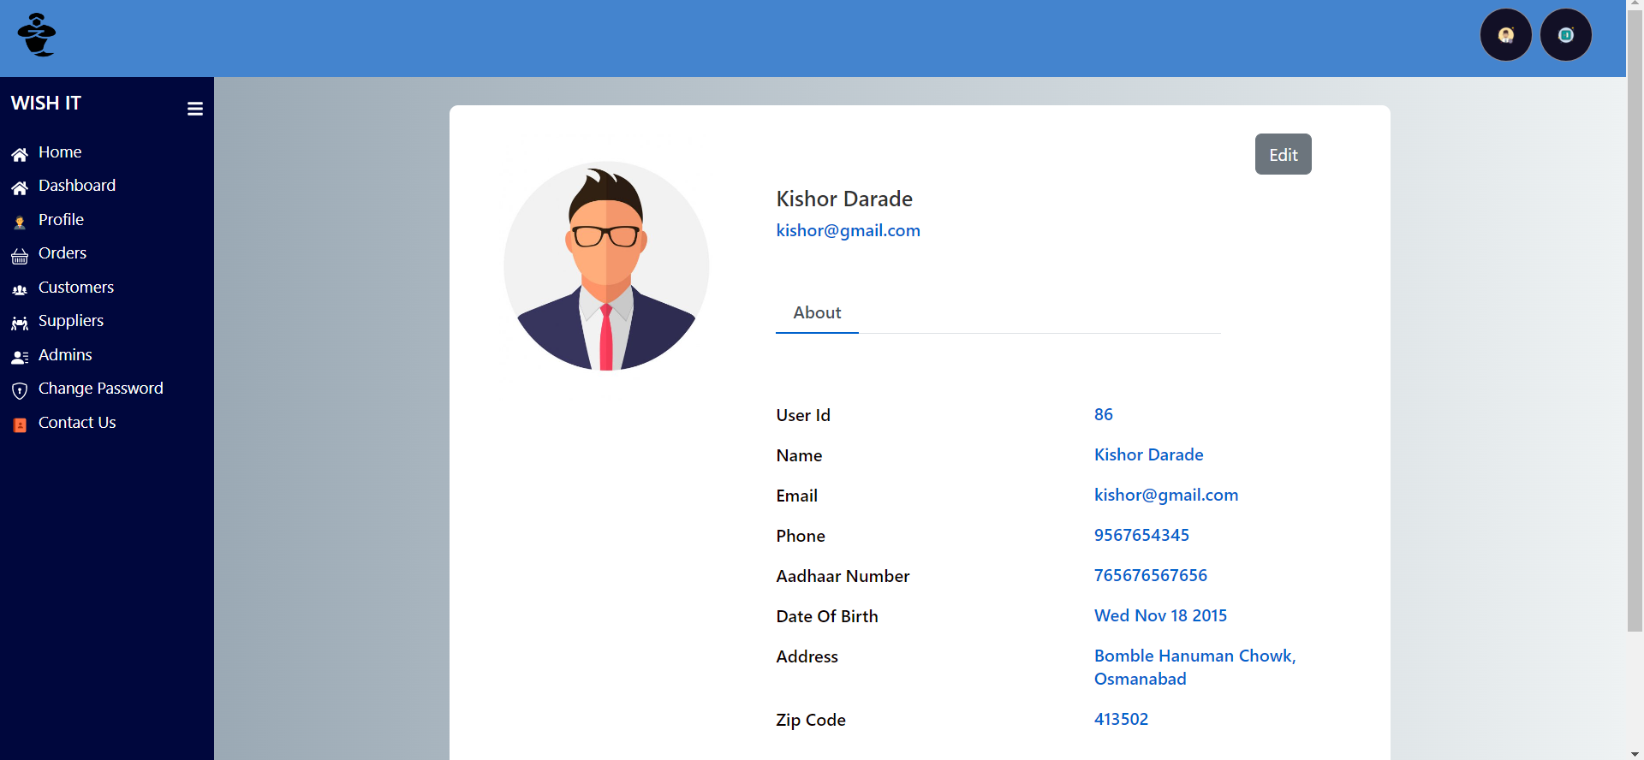
SCREENSHOTS- PROFILE PAGE

Slide 14
SYSTEM REQUIREMENTS
Software Requirements:
Windows 7 & above.
VS Code 1.x and above for REACT, JS, NODE express, Bootstrap, HTML, CSS.
Eclipse Oxygen and above stable version (J2SE).
Spring Tool Suite 4.x or any stable version.
Postman
MySQL 8.x or any stable version.
Git Hub
Hardware Components:
Processor – i3 and above.
Hard Disk – up to 3GB.
Memory – up to 1GB RAM
Docker- containerization platform

Slide 15

TECHNOLOGIES
REACTJS
JAVASCRIPT
HTML
CSS
WEB JAVA with Spring REST API
JAVA Persistence API (JPA)
Aspect Oriented Programming(AOP)
JWT Token
Spring Eureka(Microservices)
JUnit5
Git Hub
MYSQL
JAVA JDK1.8
Docker

Slide 16
APPLICATIONS
DIGITAL MARKETING OF LOCAL BUSINESSES
DAILY ROUTINE PROFESSIONALS
HOME SERVICES
MAINTENANCE AND REPAIRS

Slide 17
ADVANTAGES
The home service app provides convenience
Customer Relationship Management
It has a lower cost.
Save Time
Don’t have to do extensive background checks, as the app does it for you.
Eliminates Intermediate fares.

Slide 18
LIMITATIONS
Limited Sampling and Respondent Availability
Certain populations are less likely to have internet access and to respond to online questionnaires.
Possible Cooperation Problems
No Physical Interviewer
The lack of a trained interviewer to clarify and probe can lead to less reliable data.

Slide 19
CONCLUSION
To reduce burden in finding in-house solutions for the services, the proposed system provides several services by providing service specialists at your doorstep in one click.
A systematic mobile environment to system clients offers ease in accessing our services in a more comfortable way.
With well qualified and background demonstrated professionals we make all your home cleaning, plumbing, furniture maintenance, electrical works, appliance repair, house painting, vehicle service and many other services to be done in a click anytime from anywhere as easy as available.

Slide 20
FUTURE SCOPE
The online household services application provides some of the home services which are most frequently used.
This system accommodates the changing needs of the end user.
The overall system can be designed so that its capacity can be increased in response to the further requirements for which the application provides an appropriate service overseas.
Further this application can be prolonged by merely adding up the required services and additional payment systems. For example, the current system provides the following services such as home painting, home cleaning, packers and movers, plumber repair and service further the system can be extended as per the requirements of the user.
The system can have prolonged by adding the services such as mobile and various electronic repair, laundry services, catering services and many more.

Slide 21
REFRENCES
Mrs. Ulka Joshi Ma`am to coordinate and support during project.
Mrs. Harshita Maheshwari Ma`am, for guiding us throughout the project.
International Journal of Engineering Research & Technology (IJERT) An Online System for Household Services. Special Issue – 2018.
Website & YouTube Channels – Durga Software Solutions, Stackoverflow, Geeksforgeeks, Javatpoint, W3schools, Daily code buffer, Java Techie, Edureka, Gatesmashers, Java brains, Learn code with Durgesh, Naresh i technologies, Neso Academy, Sanjeev Thiyagarajan, Smart programming, TechEFX, WsCube Tech, Krish Dinesh.
Special thanks to Infoway Solutions Pvt Ltd. for providing us the knowledge and giving us capability to deal with new technologies during the project.

Slide 22
WISH-IT SOLUTIONS
SAY HELLO TO US!
Ultimate Destination for Home Utility Services
Prashant Darade [220343120029] 8956216939
Kunal Kshirsagar [220343120050] 8237251602
Vikas Patil [220343120076]9309716565
Pranit Ghorpade [220343120081]86000092305
Contact
prashantdaradewpt@gmail.com
All Rights Reserved by – WISH-IT SOLUTIONS(2022)

